Slide 1


Python Course
An Introduction to Programming
Danielle Nativ, Nikki van Ommeren & Stijn Meijer
New York • 5 September 2019

Slide 2

Programming: writing down flowcharts
Stacking abstraction layers
Automating means giving orders to a machine. These orders need to be precise (or expect erroneous behaviour).
Often a choice has to be made as to which action to perform next. The conditions for such a choice need to be made explicit, just like in a flowchart.
The grammar of a programming language is strict. This is called the syntax of the language.
Combinations of orders may be applicable multiple times. These can be abbreviated, which results in a higher abstraction level. An example is the functionality of a coffee machine.
Notes:
Coffee machine example.

Slide 3
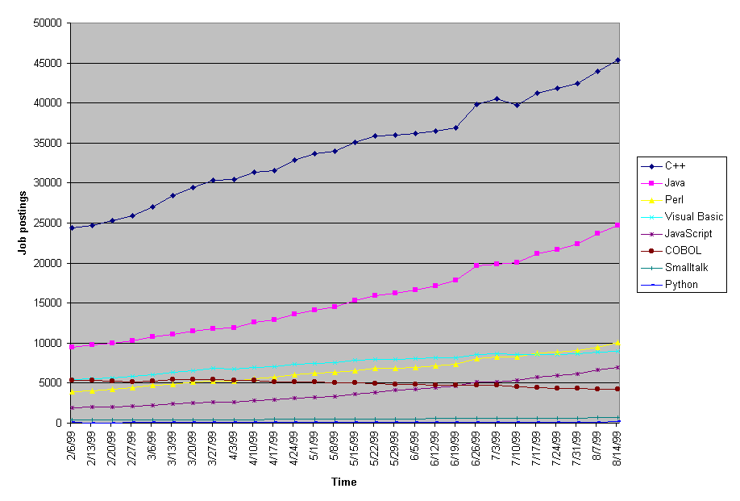
Why Python?

Slide 4
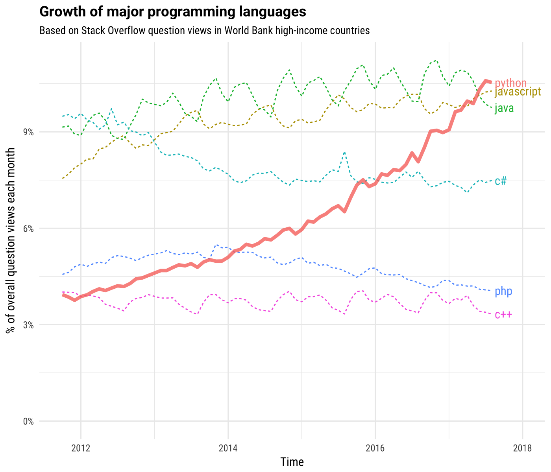
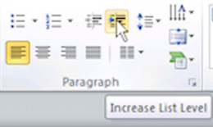
Using bullets with indent button
Use the indent button to create the text levels with the appropriate bullet.

Slide 5
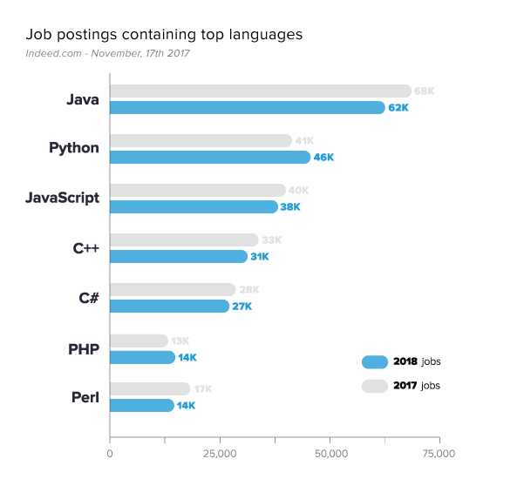

Slide 6
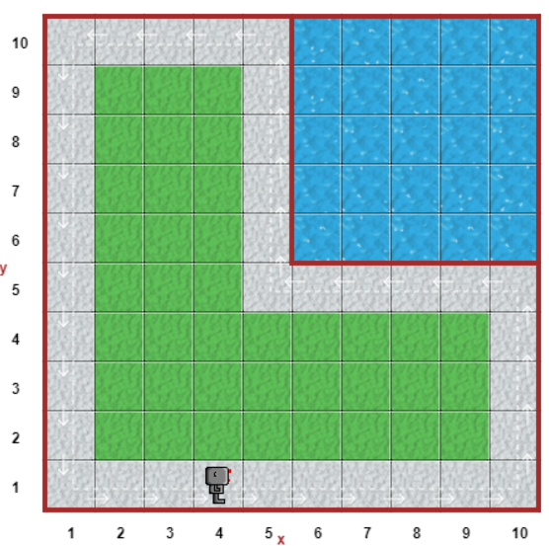
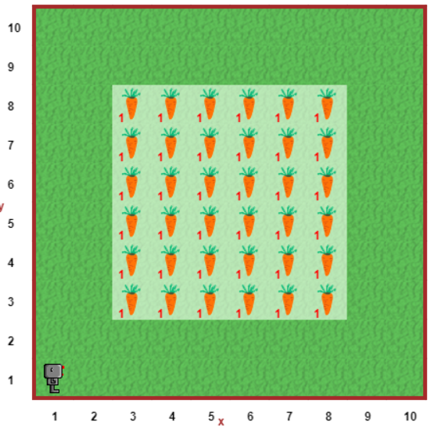
Puzzle – teaser
Around 2
Harvest 1
After
the lecture:
GO!

Slide 7
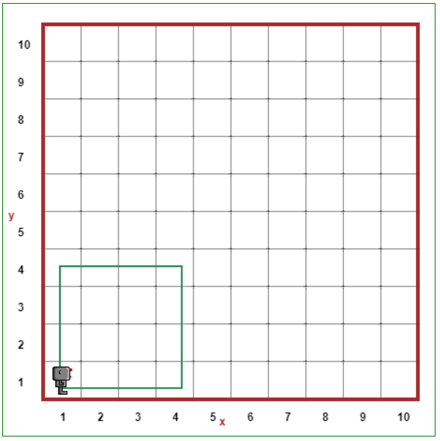
Concepts in Programming
Using bullets with indent button
Use the indent button to create the text levels with the appropriate bullet.
Notes:
On whiteboard:
Run a program
Comments
Functions
Indentation
Loops (for)
Code backup:
# Move a given number of grids
def move_steps_and_turn(steps):
for i in range(0, steps):
move()
turn_left()
# Set speed
think(100)
# Walk in square
for i in range(0, 4):
move_steps_and_turn(5)

Slide 8

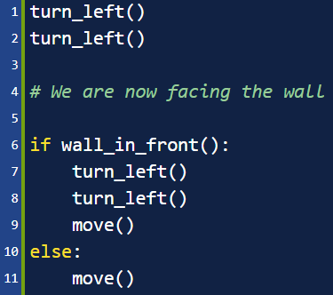
Concepts in Programming (cont.d)
Using bullets with indent button
Use the indent button to create the text levels with the appropriate bullet.
If / else: conditionals in Python
Like in a flowchart, often we need to make a decision based on some condition.
if [condition]:
turn_left()
elif [another condition]:
turn_right()
else:
move()
The [condition] can contain operands like not, and, or, … such as: if wall_in_front() and not object_here():
turn_left()
object_here is a function, that’s why there is () after it

Slide 9
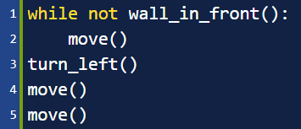
Concepts in Programming (cont.d)
Using bullets with indent button
Use the indent button to create the text levels with the appropriate bullet.
While: conditional loop in Python
Certain decisions need to be repeated as long as some condition holds.
while [condition]:
move()
The indented code is executed over and over again, until the condition no longer holds.
You need to be careful that the condition eventually no longer holds – otherwise it might run ‘forever’ and your application will crash.
The repetition can also be stopped manually, using break. You can create an infinite loop with the condition True, then using break after some if/else-condition within the looped code.

Slide 10
How to define a function
Puzzle – assignment
Around 2
Actions you can take
move() - take a single step
turn_left() - take a left turn
put() - place a ball
take() - pick up object underneath
Conditions you can check
wall_in_front() - whether there is a wall facing you
wall_on_right() - whether there is a wall on your right
object_here() - whether there is an object underneath
Note that you may have to implement functions such as turn_right() yourself. Also you may need if/else, while, not, and, or, break, …
def some_function():
some_action() more_action()
Harvest 1

Slide 11
Puzzle – assignment
Start the assignment now:
https://bit.ly/2jYaYdl
Equal to: http://reeborg.ca/reeborg.html?lang=en&mode=python&menu=worlds%2Fmenus%2Freeborg_intro_en.json&name=Around%202&url=worlds%2Ftutorial_en%2Faround2.json
Around 2
GO!
Harvest 1

Slide 12
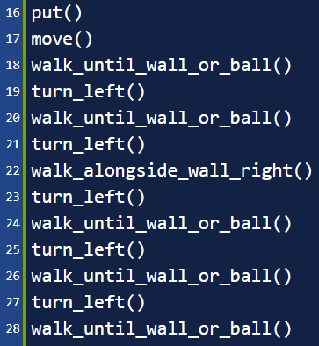
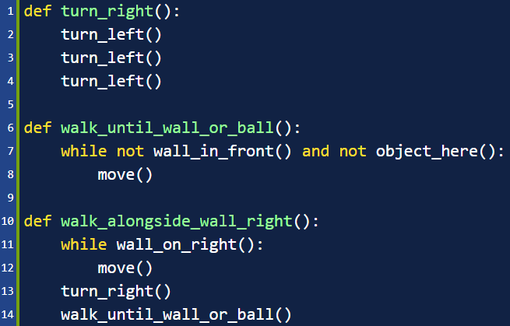
Puzzle – possible solution
Around 2

Slide 13
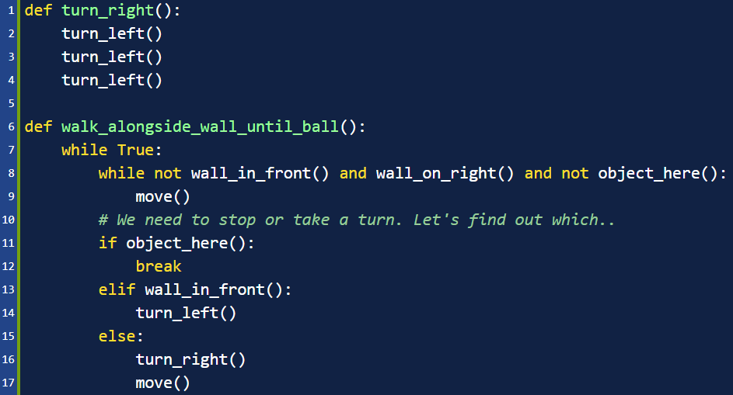
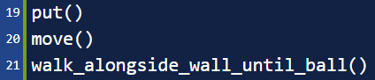
Puzzle – possible solution (2)
Around 2

Slide 14
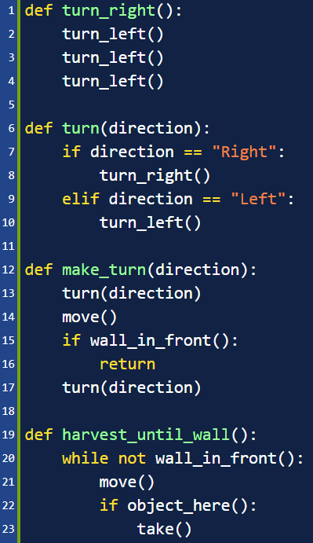
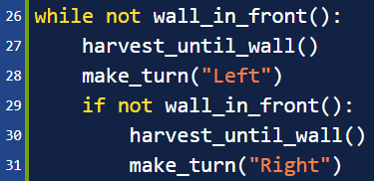
Puzzle – possible solution
Harvest 1

Slide 15

Next Steps!
Available online courses
https://www.coursera.org/
https://www.codecademy.com/learn/learn-python-3
https://www.pluralsight.com/paths/python
And feel free to try the robot's other levels anytime!
http://reeborg.ca/reeborg.html?lang=en&mode=python&menu=worlds%2Fmenus%2Freeborg_intro_en.json&name=Around%202&url=worlds%2Ftutorial_en%2Faround2.json
Notes:
TODO: which courses are free available for ING Asia employees?

Slide 16

Thank you!

